Slide 1
WELCOME
United States History I
Mrs. O’Connor
Room # C122

Slide 2
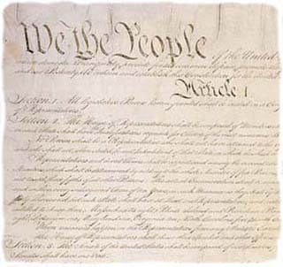
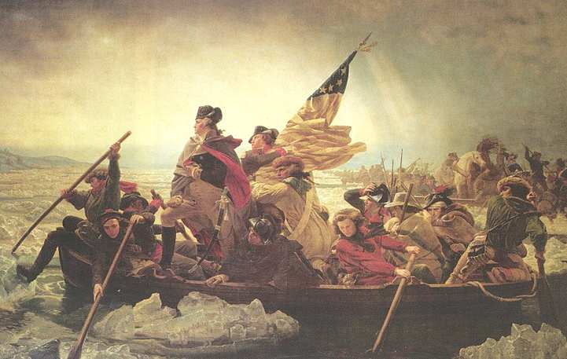
Class Description
USI is a course that moves through the history of the United States beginning with the causes of the Civil War and ending at the New Deal.
It’s purpose is to make students think about the development of American society, politics and economy.
Required Course for graduation.

Slide 3
CP Grading Policy and Homework
50% → tests, quizzes, projects
30% → homework
20%→ class work and participation
Homework will be graded
Late Work- 1 day at 50%
Absent= day for day
Absent folder

Slide 4
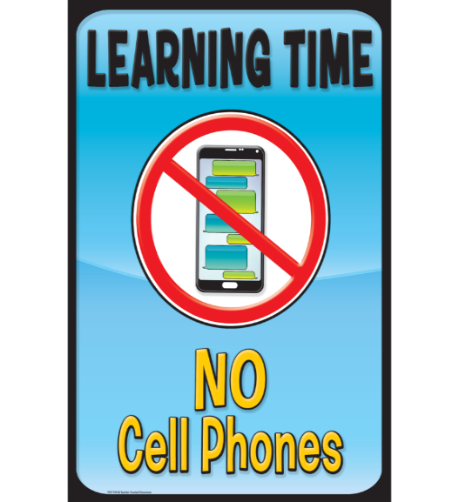
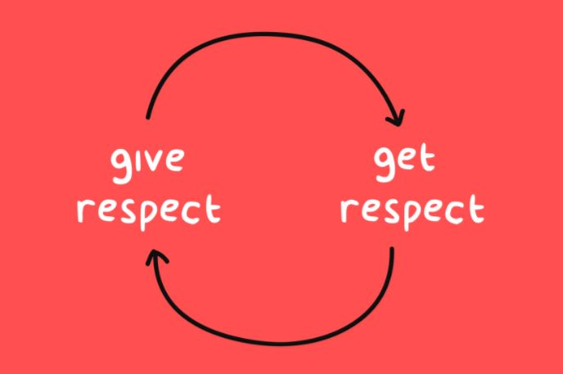
Rules- Expectations- Policies
No Phones!!!
Be an Active Learner
Academic Integrity
Come to class prepared and on time
Technology Conduct
Absences
Final Exams and Exemptions
Hats/Hoods/Headphones
Food and Drinks
New School IDs
RESPECT!!!!!

Slide 5
New Bell Schedule
Homeroom | 7:15- 7:20
Period 1 | 7:20- 8:36
Period 2 | 8:42-9:58
Common Lunch | A 10:01-10:29 B 10:29-10:57
Period 3 | 11:00-12:16
Period 4 | 12:22- 1:38
Period 5 | 1:45- 2:00

Slide 6
Common Lunch
Supervised QUIET Study Areas:
Students will be
working and noise/distractions
will be kept
to a minimum.
Supervised Study
Areas Include:
Lecture Hall - (no food)
IMC - (no food)
Auditorium - (no food)
Weight Room (no food)
Cafeterias
Gymnasiums (bleachers)
Grand Hallway
Areas around school
Supervised SOCIAL Study Areas:
Students may be collaborating or
working together.
Polite social interaction
will be permitted.
Meet with Coach and Advisors
Extra help or make up assignments/tests with teachers during office hours
Meet with friends
Study
Meet with Guidance, CST, SAC

Slide 7
Mrs. OConnor's Office Hours
 | Monday | Tuesday | Wednesday | Thursday | Friday
10:01 - 10:29 | Lunch | Lunch | Outside Library- Supervised Study Area | Lunch | Liberty Bell- Supervised Study Area
10:29 - 10:57 | Office Hours | Office Hours | Lunch | Office Hours | Lunch

Slide 8
Contact information:
Email: jloconnor@jacksonsd.org

Slide 9
WELCOME
United States History I
Honors
Mrs. O’Connor
Room # C122

Slide 10
Class Description
USI is a course that moves through the history of the United States beginning with the causes of the Civil War and ending at the New Deal.
It’s purpose is to make students think about the development of American society, politics and economy.
Required Course for graduation.

Slide 11
Honors Grading Policy and Homework
65% → tests, quizzes, projects
25% → homework
10%→ class work and participation
Homework will be graded
Late Work- 1 day at 50%
Absent= day for day
Absent folder

Slide 12
Rules- Expectations- Policies
No Phones!!!
Be an Active Learner
Academic Integrity
Come to class prepared and on time
Technology Conduct
Absences
Final Exams and Exemptions
Hats/Hoods/Headphones
Food and Drinks
New School IDs
RESPECT!!!!!

Slide 13
New Bell Schedule
Homeroom | 7:15- 7:20
Period 1 | 7:20- 8:36
Period 2 | 8:42-9:58
Common Lunch | A 10:01-10:29 B 10:29-10:57
Period 3 | 11:00-12:16
Period 4 | 12:22- 1:38
Period 5 | 1:45- 2:00

Slide 14
Common Lunch
Supervised QUIET Study Areas:
Students will be
working and noise/distractions
will be kept
to a minimum.
Supervised Study
Areas Include:
Lecture Hall - (no food)
IMC - (no food)
Auditorium - (no food)
Weight Room (no food)
Cafeterias
Gymnasiums (bleachers)
Grand Hallway
Areas around school
Supervised SOCIAL Study Areas:
Students may be collaborating or
working together.
Polite social interaction
will be permitted.
Meet with Coach and Advisors
Extra help or make up assignments/tests with teachers during office hours
Meet with friends
Study
Meet with Guidance, CST, SAC

Slide 15
Mrs. OConnor's Office Hours
 | Monday | Tuesday | Wednesday | Thursday | Friday
10:01 - 10:29 | Lunch | Lunch | Outside Library- Supervised Study Area | Lunch | Liberty Bell- Supervised Study Area
10:29 - 10:57 | Office Hours | Office Hours | Lunch | Office Hours | Lunch

Slide 16
Contact information:
Email: jloconnor@jacksonsd.org

Slide 17
WELCOME
AP United States History
Mrs. O’Connor
Room # C122

Slide 18
Class Description
APUSH is a Junior/Senior level class taught in an A/B Day format all year long. Students are required to complete summer work for the first day of class, no exceptions. An extensive amount of reading and writing will be assigned for each class and graded at a college- level. Students will be responsible for not only reading the textbook in its entirety but a variety of other primary and secondary sources as well that will help create a full picture of American History. All students enrolled in this course are required to take the AP Exam.

Slide 19
APUSH Grading Policy and Homework
70% → tests, quizzes, projects
20% → homework
10%→ class work and participation
Homework will be graded
Late Work- 1 day at 50%
Absent= day for day
Absent folder

Slide 20
APUSH Exam Information
Friday, May 5th, 2023 @ 8 a.m. → 3 hours and 15 minutes
Section I- Part A: Multiple Choice - 55 questions- 55 minutes- 40% of the Exam Score.
Section I- Part B: Short Answer- 3 Questions- 40 minutes- 20% of Exam Score
Question 1 (required): periods 3-8
Question 2 (required) periods 3-8
Students choose between Questions 3 (period 1-5) and Question 4 (periods 6-9)
Section II- Part A: Document Based- 1 Questions- 60 minutes- 25% of Exam Score
The document-based question focuses on topics from periods 3 to 8
Section II- Part B: Long Essay- 1 Question- 60 minutes- 25% of the Exam Score
Option 1: periods 1-3
Option 2: periods 4-6
Option 3: periods 7-9

Slide 21
New Bell Schedule
Homeroom | 7:15- 7:20
Period 1 | 7:20- 8:36
Period 2 | 8:42-9:58
Common Lunch | A 10:01-10:29 B 10:29-10:57
Period 3 | 11:00-12:16
Period 4 | 12:22- 1:38
Period 5 | 1:45- 2:00

Slide 22
Common Lunch
Supervised QUIET Study Areas:
Students will be
working and noise/distractions
will be kept
to a minimum.
Supervised Study
Areas Include:
Lecture Hall - (no food)
IMC - (no food)
Auditorium - (no food)
Weight Room (no food)
Cafeterias
Gymnasiums (bleachers)
Grand Hallway
Areas around school
Supervised SOCIAL Study Areas:
Students may be collaborating or
working together.
Polite social interaction
will be permitted.
Meet with Coach and Advisors
Extra help or make up assignments/tests with teachers during office hours
Meet with friends
Study
Meet with Guidance, CST, SAC

Slide 23
Mrs. OConnor's Office Hours
 | Monday | Tuesday | Wednesday | Thursday | Friday
10:01 - 10:29 | Lunch | Lunch | Outside Library- Supervised Study Area | Lunch | Liberty Bell- Supervised Study Area
10:29 - 10:57 | Office Hours | Office Hours | Lunch | Office Hours | Lunch

Slide 24
Contact information:
Email: jloconnor@jacksonsd.org

Slide 25
WELCOME
Man’s Inhumanity to Mankind
Mrs. O’Connor
Room # C122

Slide 26
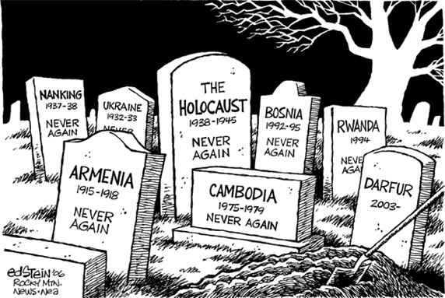
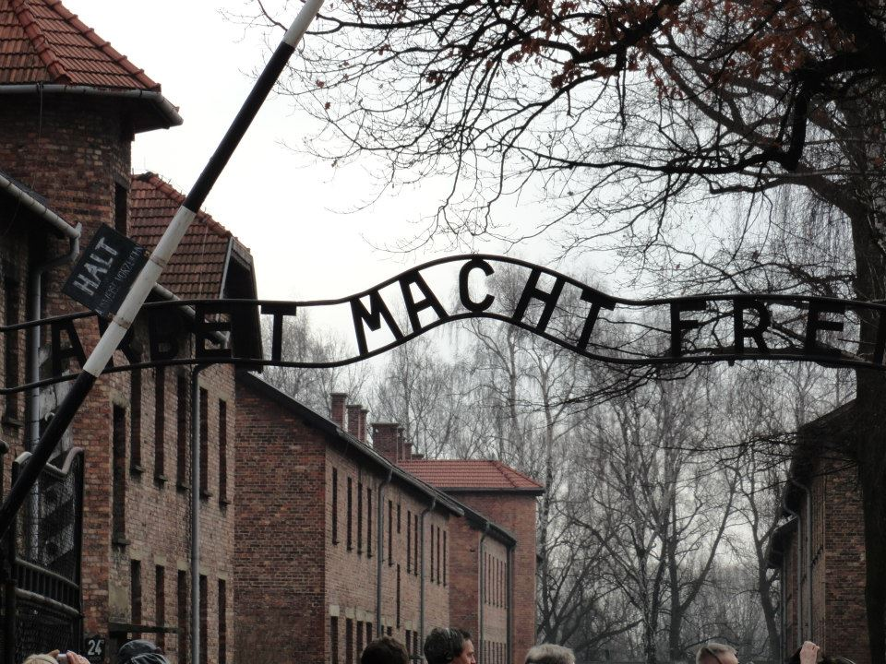
Class Description
Man’s Inhumanity is a one semester elective course offered to Juniors and Seniors.
We focus on the study of genocides, atrocities, and ethical issues from the past and the present.
Topics include:
The Nature of Man→ (Good vs Evil)
Native Americans studies
African-American studies
The Great Irish Famine
Armenian Genocide
The Holocaust
Cambodian Genocide
The Arab-Israeli Conflict
The War in Iraq and Afghanistan
Modern genocides in Africa in the 1990s and 2000s
Social issues facing the United States today

Slide 27
Man’s Grading Policy and Homework
50% → tests, quizzes, projects
30% → homework
20%→ class work and participation
Homework will be graded
Late Work- 1 day at 50%
Absent= day for day
Absent folder

Slide 28
Rules- Expectations- Policies
No Phones!!!
Be an Active Learner
Academic Integrity
Come to class prepared and on time
Technology Conduct
Absences
Final Exams and Exemptions
Hats/Hoods/Headphones
Food and Drinks
New School IDs
RESPECT!!!!!

Slide 29
New Bell Schedule
Homeroom | 7:15- 7:20
Period 1 | 7:20- 8:36
Period 2 | 8:42-9:58
Common Lunch | A 10:01-10:29 B 10:29-10:57
Period 3 | 11:00-12:16
Period 4 | 12:22- 1:38
Period 5 | 1:45- 2:00

Slide 30
Common Lunch
Supervised QUIET Study Areas:
Students will be
working and noise/distractions
will be kept
to a minimum.
Supervised Study
Areas Include:
Lecture Hall - (no food)
IMC - (no food)
Auditorium - (no food)
Weight Room (no food)
Cafeterias
Gymnasiums (bleachers)
Grand Hallway
Areas around school
Supervised SOCIAL Study Areas:
Students may be collaborating or
working together.
Polite social interaction
will be permitted.
Meet with Coach and Advisors
Extra help or make up assignments/tests with teachers during office hours
Meet with friends
Study
Meet with Guidance, CST, SAC

Slide 31
Mrs. OConnor's Office Hours
 | Monday | Tuesday | Wednesday | Thursday | Friday
10:01 - 10:29 | Lunch | Lunch | Outside Library- Supervised Study Area | Lunch | Liberty Bell- Supervised Study Area
10:29 - 10:57 | Office Hours | Office Hours | Lunch | Office Hours | Lunch

Slide 32
Contact information:
Email: jloconnor@jacksonsd.org

